Slide 1

Self-Balancing Unicycle
Introduction
Recap
Controls
Code
Testing
Problems
Lessons
Robot
Suggestions
Conclusion
Client: Andy Chang (National Instruments)
Supervisor: Dr. Robert Throne
Leader: Kevin Collins
Members: Spencer Carver
Ander Solorzano
Ruffin White-Magner
Team
G
Notes:
Kevin

Slide 2
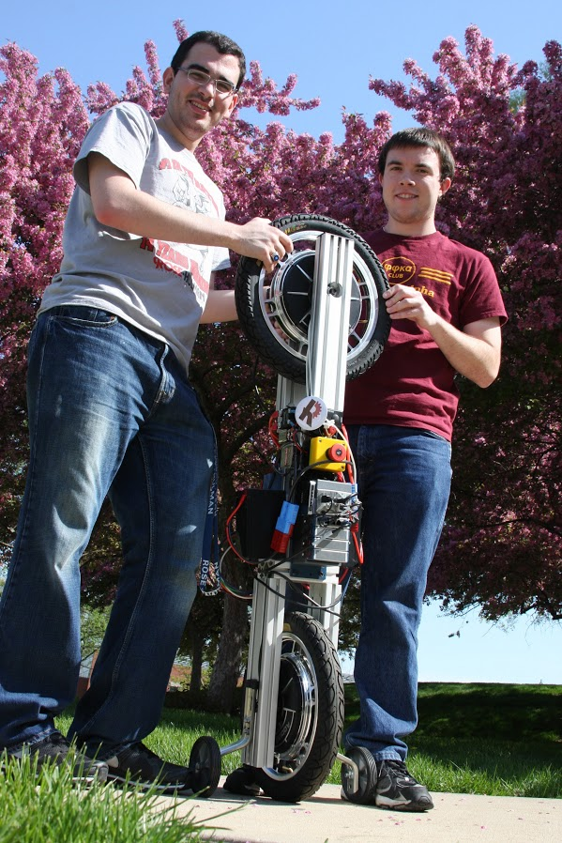
Introduction
Recap
Controls
Code
Testing
Problems
Lessons
Robot
Suggestions
Conclusion
Build a self-balancing robotic unicycle for National Instruments (NI), using NI components where possible
Notes:
Kevin –

Slide 3
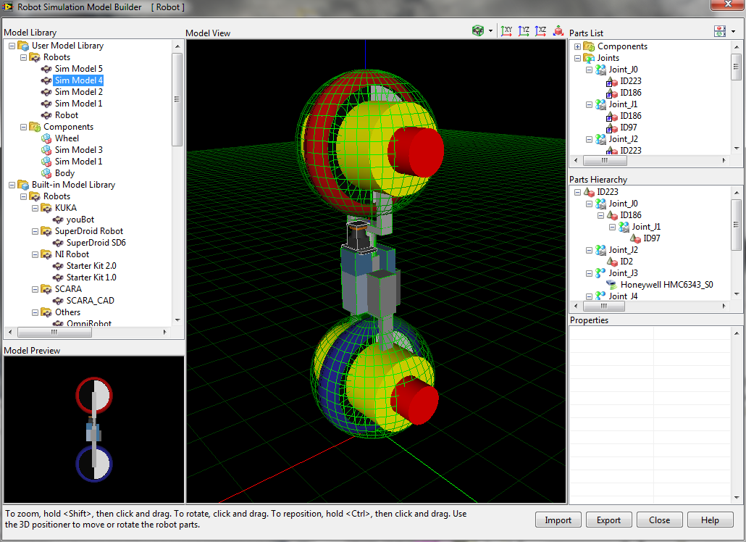
Introduction
Recap of Fall
Controls
Code
Testing
Problems
Lessons
Robot
Suggestions
Conclusion
Notes:
Kevin

Slide 4
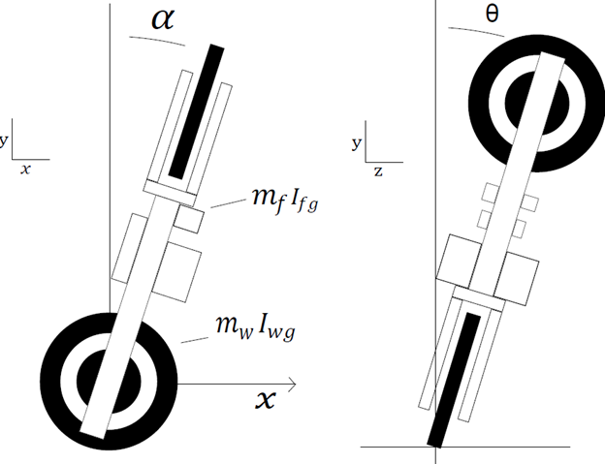
Introduction
Recap of Fall
Controls
Code
Testing
Problems
Lessons
Robot
Suggestions
Conclusion
Notes:
Kevin

Slide 5
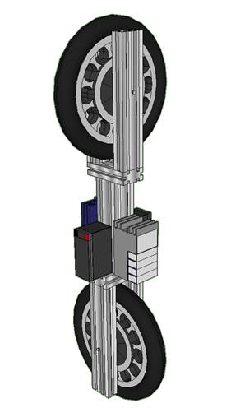
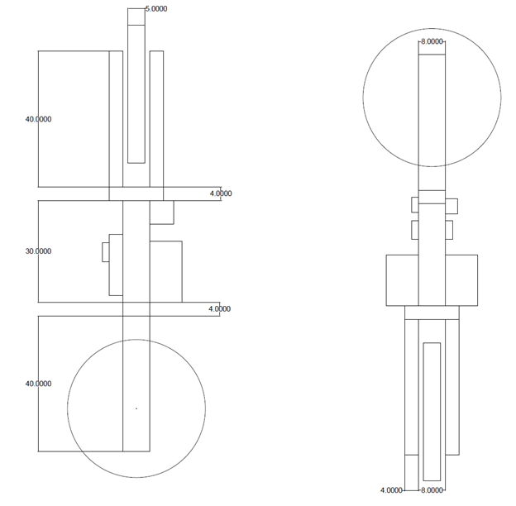
Introduction
Recap of Winter
Controls
Code
Testing
Problems
Lessons
Robot
Suggestions
Conclusion
Build a self-balancing robotic unicycle for National Instruments (NI), using NI components where possible
Notes:
Kevin

Slide 6
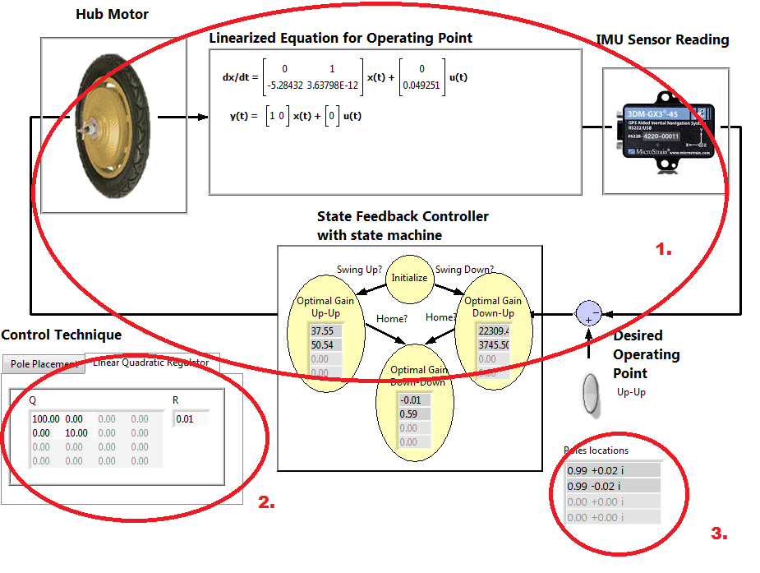
Introduction
Recap
Control System – Closed Loop System Overview
Code
Testing
Problems
Lessons
Robot
Suggestions
Conclusion
This is the closed-loop system controller layout for the entire system. The state feedback controller sets the control efforts which affect the torque being applied to the motors. The changes in torque change the state-space model. Changes detected by the IMU allow the controller to compute new gains.
The user can select the type of controller: Linear Quadratic Regulator or Ackermann pole placement.
The pole locations of the state machine controller are then displayed for user purposes.
Notes:
Ander

Slide 7
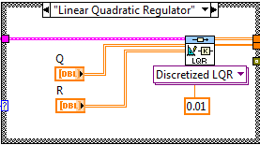
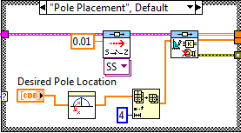
Introduction
Recap
Control System – Controller Approaches
Code
Testing
Problems
Lessons
Robot
Suggestions
Conclusion
Linear Quadratic Regulator
Ackermann Pole Placement
Optimality controller that assigns costs to certain states to prioritize the effort.
An approach that allows us to identify the controllability matrix assuming that the system is controllable
The system must be linearized to assign the costs or weights to the states.
The state-feedback gain matrix can then found after identifying the controllability matrix.
The Q vector is a square MxM matrix where M is the total number of states present in the model.
The user has to preset the desired system poles and pass in a discretized system model.
The R vector is a scalar that multiples to the input of the state-space model.
The controller determines the gains to placed the poles at the desired location
Notes:
Ander

Slide 8
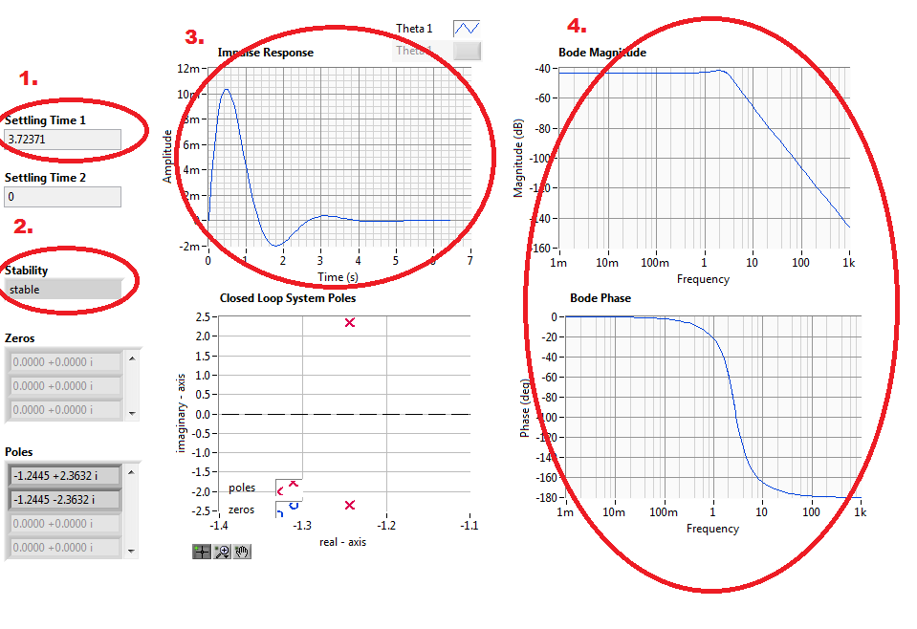
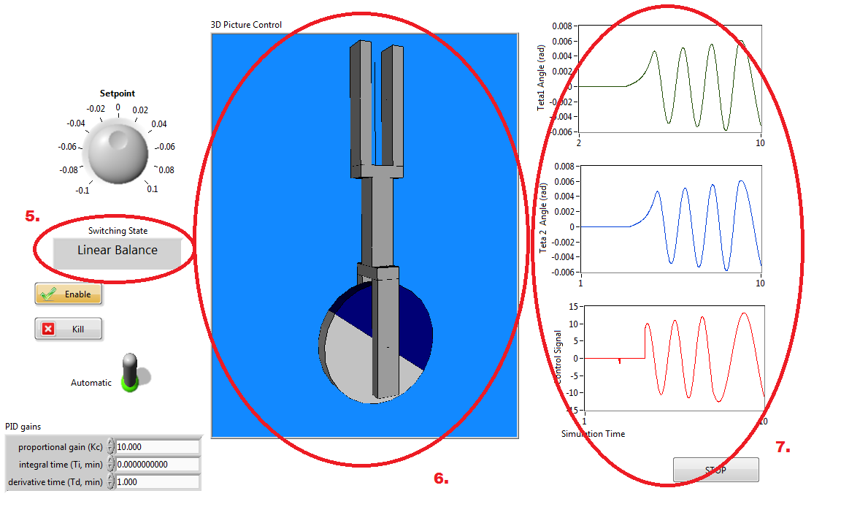
Introduction
Recap
Control System – Analysis in LabVIEW
Code
Testing
Problems
Lessons
Robot
Suggestions
Conclusion
Displays the settling time of a controllable system.
Displays whether the system can reach stability or not.
Displays the impulse response of the controller. This can be used to determined if the system can reach a steady-state response.
The user can see the Bode plots for the calculated system poles of the closed-loop transfer function.
5. The user can see the real-time status of the state machine controller.
6. The system was given a user-friendly visualization for behavioral responses.
7. The user can monitor the status of the states and the control signal that sets the motor speeds and directions.
Notes:
Ander

Slide 9
Introduction
Recap
Controls
Code
Testing
Problems
Lessons
Robot
Suggestions
Conclusion
Notes:
Spencer

Slide 10
Recap
Controls
Code
Testing Plan
Problems
Lessons
Robot
Suggestions
Conclusion
Notes:
Spencer

Slide 11
Controls
Code
Testing
Problems Encountered
Lessons
Robot
Suggestions
Conclusion
Notes:
Spencer

Slide 12
Code
Testing
Problems
Other Lessons Learned
Robot
Suggestions
Conclusion
Notes:
Ruffin

Slide 13
Testing
Problems
Lessons
Robot
Suggestions
Conclusion
Notes:
Ruffin

Slide 14
Problems
Lessons
Robot
Recommendations
Conclusion
Notes:
Ruffin

Slide 15
Lessons
Robot
Suggestions
Conclusion - Questions?
Notes:
Ruffin

